Slide 1


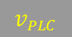
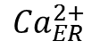
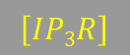
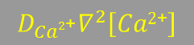
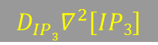

Molecular mechanism of calcium propagation
Ca²⁺
PLC-γ
PIP₂
$$J_{media}$$
$$v_{PLC}$$
IP₃
IP₃
Ca²⁺
$$D_{IP3}∇^{2}\left[IP3\right]$$
IP₃
$$D_{Ca2\text{+}}∇^{2}\left[Ca2\text{+}\right]$$
$$J_{flux}$$
+
+
Ca²⁺
SERCA
-
IP₃R
$$\left[IP3R\right]$$
Gap Junction
Ca²⁺
$$J_{SERCA}$$
$${Ca}_{ER}^{2+}$$
ER

Slide 2
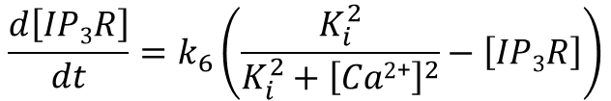
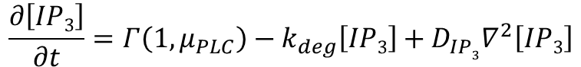
PDE model (Version 1)
$$\frac{∂\left[Ca2\text{+}\right]}{∂t}=\frac{\left(k_{1}+k_{2}\left[IP3R\right]{\left[Ca2\text{+}\right]}^{2}{\left[IP3\right]}^{2}\right)\left(\left[{Ca}_{ER}^{2+}\right]−\left[Ca2\text{+}\right]\right)}{\left(K_{Ca2\text{+}}^{2}+\left[Ca2\text{+}\right]2\right)\left(K_{IP3}^{2}+\left[IP3\right]2\right)}−\frac{v_{SERCA}{\left[{Ca}^{2+}\right]}^{2}}{{k_{SERCA}^{2}+\left[{Ca}^{2+}\right]}^{2}}+v_{leak}\left(k_{leak}−\left[Ca2\text{+}\right]\right)+D_{Ca2\text{+}}∇^{2}\left[Ca2\text{+}\right]$$
$$\frac{d\left[{Ca}_{ER}^{2+}\right]}{dt}=−\frac{V}{V_{ER}}\left(\frac{\left(k_{1}+k_{2}\left[IP3R\right]{\left[Ca2\text{+}\right]}^{2}{\left[IP3\right]}^{2}\right)\left(\left[{Ca}_{ER}^{2+}\right]−\left[Ca2\text{+}\right]\right)}{\left(K_{Ca2\text{+}}^{2}+\left[Ca2\text{+}\right]2\right)\left(K_{IP3}^{2}+\left[IP3\right]2\right)}−\frac{v_{SERCA}{\left[{Ca}^{2+}\right]}^{2}}{{k_{SERCA}^{2}+\left[{Ca}^{2+}\right]}^{2}}\right)$$
$$\frac{∂\left[IP3\right]}{∂t}=Γ\left(1,μ_{PLC}\right)−k_{deg}\left[IP3\right]+D_{IP3}∇^{2}\left[IP3\right]$$
$$\frac{d\left[IP3R\right]}{dt}=k_{6}\left(\frac{K_{i}^{2}}{{K_{i}^{2}+\left[Ca2\text{+}\right]}^{2}}−\left[IP3R\right]\right)$$
Notes:
Formal separate PLCg term

Slide 3
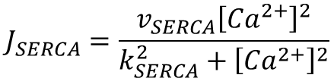
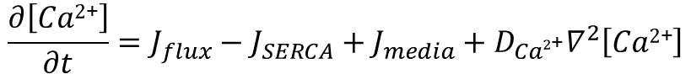
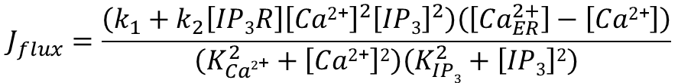
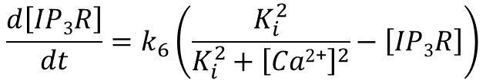
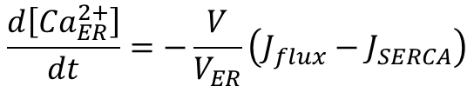
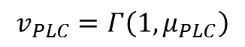
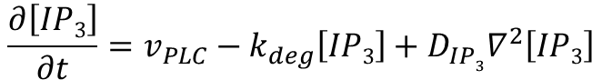
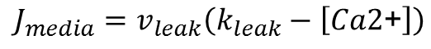
PDE model (Version 2)
$$\frac{∂\left[Ca2\text{+}\right]}{∂t}=J_{flux}−J_{SERCA}+J_{media}+D_{Ca2\text{+}}∇^{2}\left[Ca2\text{+}\right]$$
$$J_{flux}=\frac{\left(k_{1}+k_{2}\left[IP3R\right]{\left[Ca2\text{+}\right]}^{2}{\left[IP3\right]}^{2}\right)\left(\left[{Ca}_{ER}^{2+}\right]−\left[Ca2\text{+}\right]\right)}{\left(K_{Ca2\text{+}}^{2}+\left[Ca2\text{+}\right]2\right)\left(K_{IP3}^{2}+\left[IP3\right]2\right)}$$
$$\frac{d\left[IP3R\right]}{dt}=k_{6}\left(\frac{K_{i}^{2}}{{K_{i}^{2}+\left[Ca2\text{+}\right]}^{2}}−\left[IP3R\right]\right)$$
$$J_{SERCA}=\frac{v_{SERCA}{\left[{Ca}^{2+}\right]}^{2}}{{k_{SERCA}^{2}+\left[{Ca}^{2+}\right]}^{2}}$$
$$\frac{d\left[{Ca}_{ER}^{2+}\right]}{dt}=−\frac{V}{V_{ER}}\left(J_{flux}−J_{SERCA}\right)$$
$$J_{media}=v_{leak}\left(k_{leak}−\left[Ca2\text{+}\right]\right)$$
$$\frac{∂\left[IP3\right]}{∂t}=v_{PLC}−k_{deg}\left[IP3\right]+D_{IP3}∇^{2}\left[IP3\right]$$
$$v_{PLC}=Γ\left(1,μ_{PLC}\right)$$
Notes:
Formal separate PLCg term

Slide 4
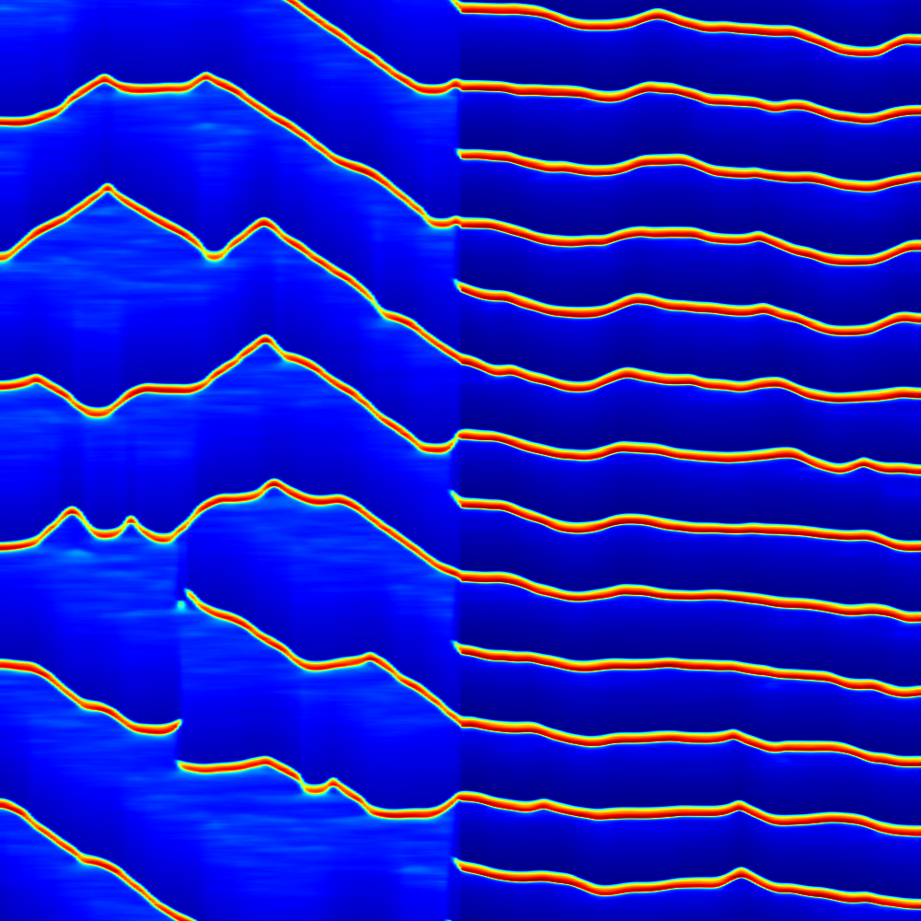
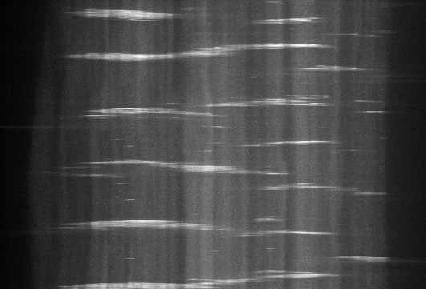
Boundary penetrance may be explained by differential cell properties in compartments
K_{Ca} = 0.20
K_{Ca} = 0.14
Time
Anterior
Posterior
Anterior
Posterior
Position
Notes:
If refractory period of one compartment is different, sometimes a wave will move through the A/P boundary and sometimes not, resulting in variable frequency. This was observed ex vivo as well.

Slide 5

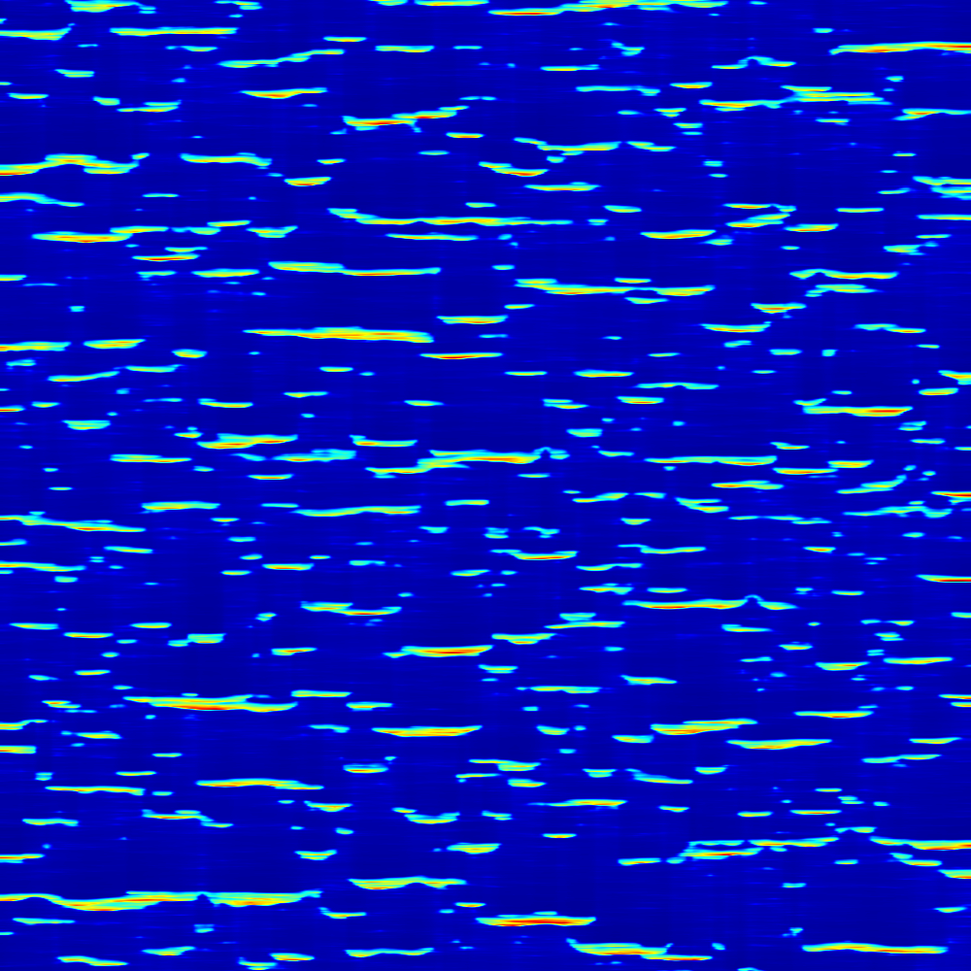
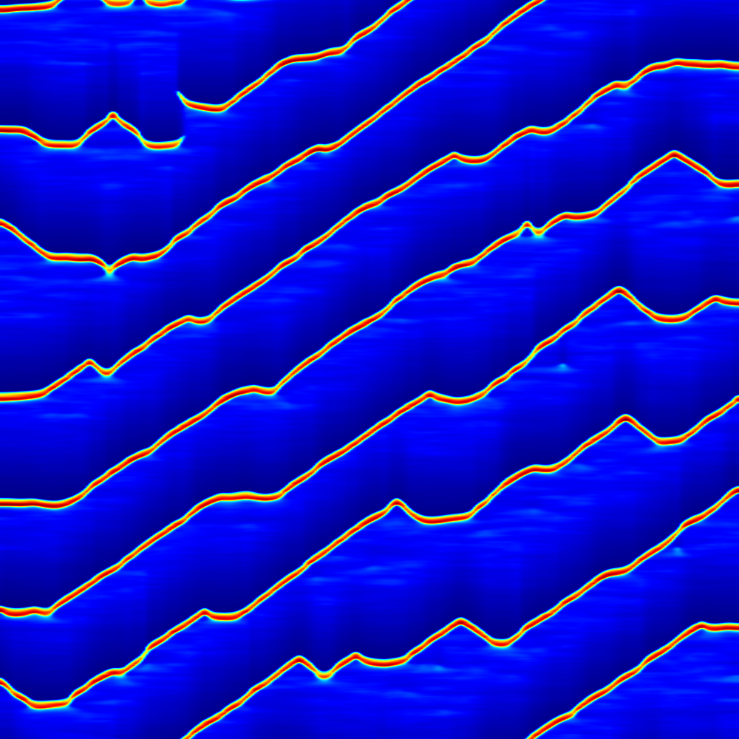
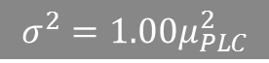
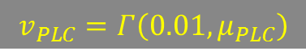
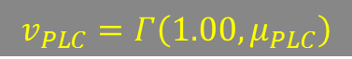
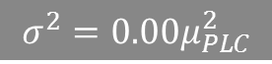
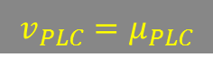

Signal variance may explain pulse to wave transition
Variance
$$σ^{2}=0.00μ_{PLC}^{2}$$
$$σ^{2}=0.01μ_{PLC}^{2}$$
$$σ^{2}=1.00μ_{PLC}^{2}$$
Time (s, 8000-10000)
$$v_{PLC}=μ_{PLC}$$
$$v_{PLC}=Γ\left(0.01,μ_{PLC}\right)$$
$$v_{PLC}=Γ\left(1.00,μ_{PLC}\right)$$
Position (𝜇m, 0-300)
t = 8000s to 10000s
Notes:
Variance of gamma distribution is alpha/theta^2 where alpha is the first input, and theta is the second input

Slide 6
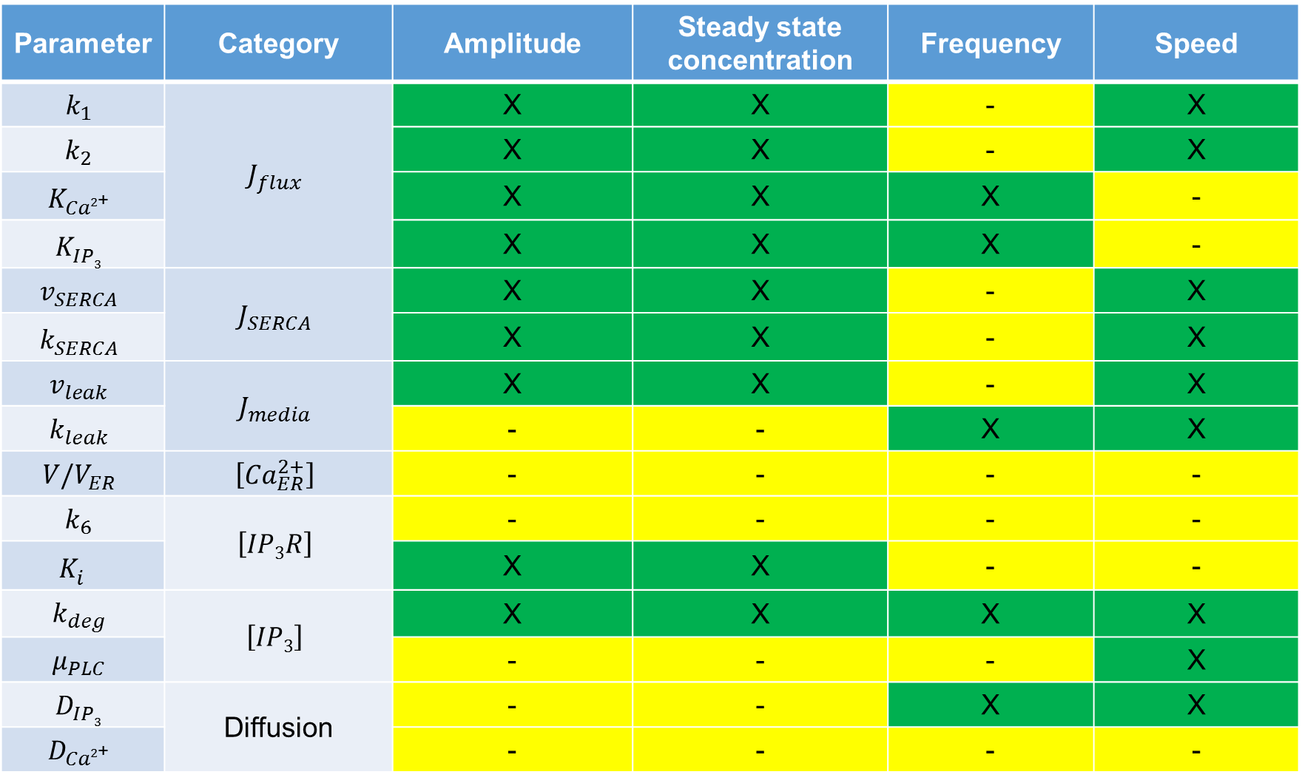
Parameter sensitivity results
Parameter | Category | Amplitude | Steady state concentration | Frequency | Speed
$$k_{1}$$ | $$J_{flux}$$ | X | X | - | X
$$k_{2}$$ |  | X | X | - | X
$$K_{Ca2\text{+}}^{}$$ |  | X | X | X | -
$$K_{IP3}^{}$$ |  | X | X | X | -
$$v_{SERCA}$$ | $$J_{SERCA}$$ | X | X | - | X
$$k_{SERCA}^{}$$ |  | X | X | - | X
$$v_{leak}$$ | $$J_{media}$$ | X | X | - | X
$$k_{leak}$$ |  | - | - | X | X
$$V/V_{ER}$$ | $$\left[{Ca}_{ER}^{2+}\right]$$ | - | - | - | -
$$k_{6}$$ | $$\left[IP3R\right]$$ | - | - | - | -
$$K_{i}^{}$$ |  | X | X | - | -
$$k_{deg}$$ | $$\left[IP3\right]$$ | X | X | X | X
$$μ_{PLC}$$ |  | - | - | - | X
$$D_{IP3}$$ | Diffusion | - | - | X | X
$$D_{Ca2\text{+}}$$ |  | - | - | - | -
Notes:
X means effect was observed.
- means no effect was observed.
Parameters were varied by 30% up and down.
Amplitude is the concentration of calcium at the maximum.
Steady state concentration is the concentration of calcium at the minimum.
Frequency is the number of wavefronts occurring per time.
Speed is the slope of the position/time curve of the wavefronts.

Slide 7
OTHER SLIDES:

Slide 8
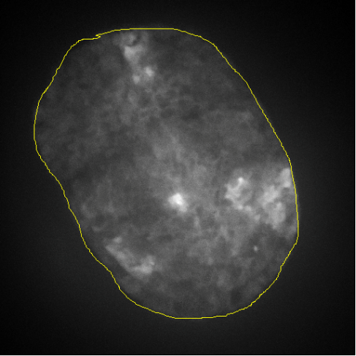
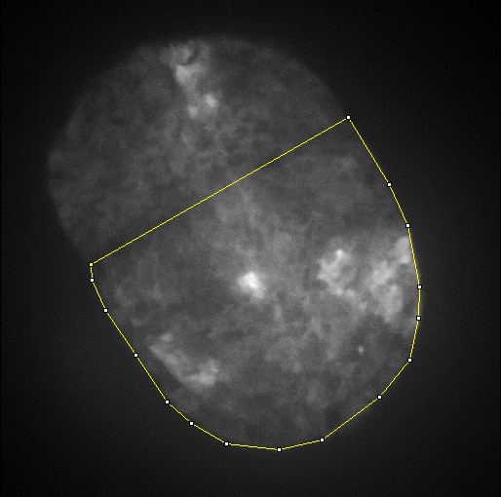
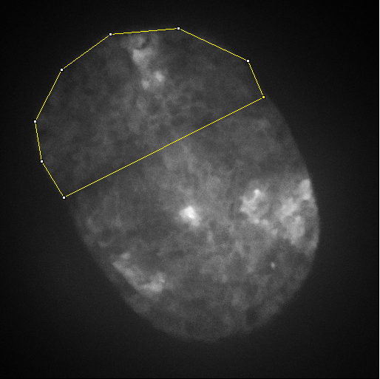
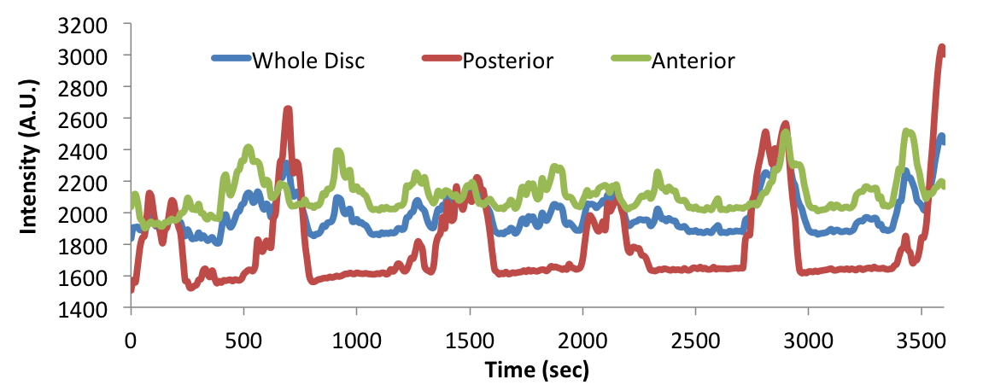
Domain specificity of Ca²⁺ transients
Whole disc
Anterior
Posterior

Slide 9
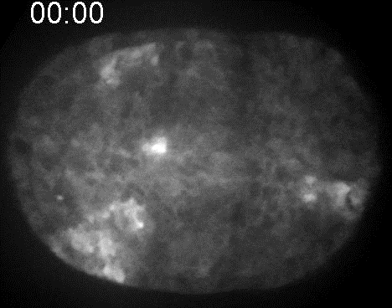

Slide 10
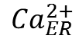
Molecular mechanism of calcium propagation
Ca²⁺
Mechanical
Stimulation
PLC-γ
PIP₂
+
TRPN Channel
(2)
(9)
(3)
IP₃
IP₃
(4)
Ca²⁺
IP₃
(1)
(6)
(8)
+
+
(7)
Ca²⁺
SERCA
-
IP₃R
Gap Junction
Ca²⁺
(5)
$${Ca}_{ER}^{2+}$$
ER

Slide 11
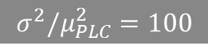
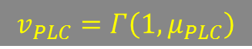
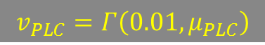
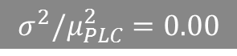
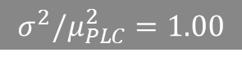
THIS SLIDE IS WRONG
Variance
$$σ^{2}/μ_{PLC}^{2}=0.00$$
$$σ^{2}/μ_{PLC}^{2}=1.00$$
$$σ^{2}/μ_{PLC}^{2}=100$$
Time (s, 8000-10000)
$$v_{PLC}=μ_{PLC}$$
$$v_{PLC}=Γ\left(1,μ_{PLC}\right)$$
$$v_{PLC}=Γ\left(0.01,μ_{PLC}\right)$$
Position (𝜇m, 0-300)
t = 8000s to 10000s
Notes:
Variance of gamma distribution is alpha/theta^2 where alpha is the first input, and theta is the second input

